Slide 1
SESSION 38
Model Optimization
ONNX export · TensorRT · quantization · pruning
Making a trained model fast enough, small enough and cheap enough to actually ship.
COMPUTER VISION & AI SERIES
THEORY SESSION
DURATION
Phase 5 · Production and Deployment
Concepts first, no coding today
30 minutes
Next up: Session 39 takes this pipeline onto real edge hardware.

Slide 2
ROADMAP
Four techniques, one shared goal
1
Why we optimize at all
A model that wins on the benchmark can still be unusable in production.
2
What we are actually optimizing
Latency, throughput, memory, model size, cost. Accuracy is the budget we spend.
3
ONNX export
Freeze the model into a portable graph that is no longer tied to PyTorch.
4
TensorRT
Compile that graph into a hardware specific engine for one NVIDIA GPU.
5
Quantization
Use fewer bits per number: FP32 to FP16 to INT8.
6
Pruning
Delete the weights and channels that were never earning their keep.
Session 38 · Model Optimization

Slide 3
WHY OPTIMIZE
Training and serving are two different jobs
Training cares about accuracy
Serving cares about the worst case
One A100 or a rented cloud GPU, batch size 64, and a run that is allowed to take hours.
Nobody watches the clock on a single image.
A Jetson on a pole, 30 frames a second, 8 camera streams, a fixed power budget and a customer waiting for the box to light up.
The clock is the product.
The gap is not small. The same YOLO detector that needs 1.06 ms per image in plain FP32 on an RTX 3080 needs 0.52 ms after export and INT8 compilation. Same weights, same architecture, half the time and a quarter of the file size.
Latency numbers: Ultralytics YOLO26 TensorRT benchmarks, RTX 3080 12GB, COCO detection.
You cannot buy your way out
The model is already trained
It is a compiler problem
Doubling GPUs doubles cost. Optimization is the only lever that improves cost per stream.
Everything today happens after training. We are not changing the architecture.
Most of the win comes from how the graph is compiled and executed, not from the maths.
Session 38 · Model Optimization

Slide 4
THE TARGETS
Optimize is five different words
1
2
3
4
5
Latency
Throughput
Memory
Model size
Cost and power
Time for one image, end to end.
Images per second at full load.
Peak VRAM while running.
Bytes on disk.
Watts and dollars per stream.
Interactive apps, robotics, AR
Batch jobs, video archives
Shared GPUs, many models per box
Edge devices, OTA updates
Anything battery or cloud billed
These pull against each other. Bigger batches raise throughput and raise latency. Lower precision cuts memory and can cost accuracy. There is no setting that wins everything, so you pick the one metric the product is judged on and treat the rest as constraints.
Accuracy is not a target, it is the budget
Every technique in this session spends a little accuracy to buy speed or size. So before you optimize anything, write down the number you refuse to go below. For a detector that is usually mAP; for a classifier, top-1; for OCR, character error rate. Without that line you cannot tell a good trade from a bad one.
Session 38 · Model Optimization

Slide 5
THE PIPELINE
From a training checkpoint to a running service
Trained model
ONNX graph
Optimized engine
Serving runtime
PyTorch .pt
Python, autograd,
training code attached
model.onnx
framework free,
one file, one standard
TensorRT .engine
compiled and tuned
for one GPU
FastAPI, Triton,
DeepStream, or your
own C++ loop
EXPORT
COMPILE
DEPLOY
Trace the model once and freeze the graph
Fuse, tune and pick precision for this GPU
Feed it frames and keep the GPU busy
Quantization and pruning are not stages. They are decisions you make inside the export and compile steps, which is why they appear later in the session rather than as their own boxes here.
Each arrow is lossy in one direction only. Once you are in ONNX you cannot train, and once you are in a TensorRT engine you cannot move to another GPU without rebuilding.
Session 38 · Model Optimization

Slide 6
ONNX · THE PROBLEM
One file every runtime agrees to read
WITHOUT A COMMON FORMAT
WITH ONNX IN THE MIDDLE
PyTorch
TensorRT
PyTorch
TensorRT
ONNX
TensorFlow
CoreML
TensorFlow
CoreML
JAX
OpenVINO
JAX
OpenVINO
3 frameworks × 3 targets = 9 converters to write and keep alive.
3 exporters + 3 importers = 6, and each new target costs one, not three.
What is actually in the file
Why the opset number matters
A protobuf holding a directed acyclic graph.
Nodes are standard operators (Conv, Relu, MatMul, Resize), edges are named tensors, and the trained weights ride along as initializers.
Operators are versioned. An export at opset 17 uses the definitions frozen in that release, so a runtime that supports opset 17 can run your model years later without you shipping PyTorch alongside it.
Session 38 · Model Optimization

Slide 7
ONNX · EXPORT
What torch.onnx.export really does
1 · Feed
2 · Trace
3 · Map
4 · Freeze
Push one dummy input
of the right shape
through the model
Record every operator
that actually executed
on that input
Translate each PyTorch
op into its ONNX
equivalent at your opset
Write graph plus
weights into a single
.onnx protobuf
Then the runtime rewrites it again
The two flags people get wrong
ONNX Runtime applies graph optimizations on load: constant folding, dropping Identity and Dropout nodes, and fusing Conv with BatchNorm or with Add. Free speed before any hardware trick.
opset_version fixes which operator definitions you are targeting.
dynamic_axes marks batch, height and width as variable, otherwise the graph is hard wired to your dummy input shape forever.
TRACING IS NOT READING YOUR CODE
An if that took the True branch on the dummy input is baked in as True, and a Python loop is unrolled to the exact number of iterations it ran.
So after every export, run the ONNX model and the PyTorch model on the same real images and compare the outputs numerically before you trust it.
Session 38 · Model Optimization

Slide 8
TENSORRT · HOW IT WORKS
A compiler, not a library
Build phase · slow, done once, offline
Runtime phase · fast, done per frame
The builder takes your ONNX graph plus a target precision and a batch profile, then physically benchmarks candidate CUDA kernels on the GPU in front of it and keeps the fastest one for every layer.
This takes minutes. It happens on your machine, not in the request path.
The output is a serialized engine, also called a plan file: the graph, the chosen kernels, and the weights in one binary.
At serving time the runtime loads that engine and executes it. No graph analysis, no kernel search, no Python.
model.onnx
portable
trtexec / builder
minutes
model.engine
binary
IExecutionContext
per frame
An engine is not portable. NVIDIA states engines are only guaranteed to work with the same OS, CPU architecture, GPU model and TensorRT version they were built with. Build on the deployment device, or build in the exact container you will deploy.
Session 38 · Model Optimization

Slide 9
TENSORRT · THE OPTIMIZATIONS
Four things the builder does for you
LAYER AND TENSOR FUSION
Conv
Bias
ReLU
CBR
3 kernel launches, 3 trips to memory
1 kernel, 1 trip
The maths is unchanged. What disappears is the launch overhead and the intermediate tensors being written to GPU memory and read straight back.
Kernel auto tuning
Precision control
There are many valid CUDA implementations of a 3x3 convolution. The builder times them on your GPU, at your shapes, and keeps the winner. This is why the engine is device specific.
You hand it a precision budget and it decides, layer by layer, where FP16 or INT8 is safe and where a layer must stay in higher precision.
Memory reuse
Streams and CUDA graphs
Tensors that are never alive at the same time share one allocation, so peak VRAM drops well below the sum of the activations.
Independent branches run concurrently, and the whole engine can be captured as a single graph launch so the CPU stops being the bottleneck.
Session 38 · Model Optimization

Slide 10
QUANTIZATION · THE FORMATS
Fewer bits per number
FP32
S
exponent · 8
mantissa · 23
32 bits
4 bytes · range ±3.4e38 · about 7 decimal digits · the training default
FP16
S
exponent · 5
mantissa · 10
16 bits
2 bytes · range ±65504 · about 3 decimal digits · the safe first win
BF16
S
exponent · 8
mantissa · 7
16 bits
2 bytes · same range as FP32, less precision · fewer overflow surprises
INT8
S
magnitude · 7
8 bits
1 byte · 256 values from -128 to +127 · needs calibration
Halving the bits does two things at once: the weights take half the space, and every read from memory moves twice as much useful data. On modern GPUs the second effect is usually the bigger one.
Session 38 · Model Optimization

Slide 11
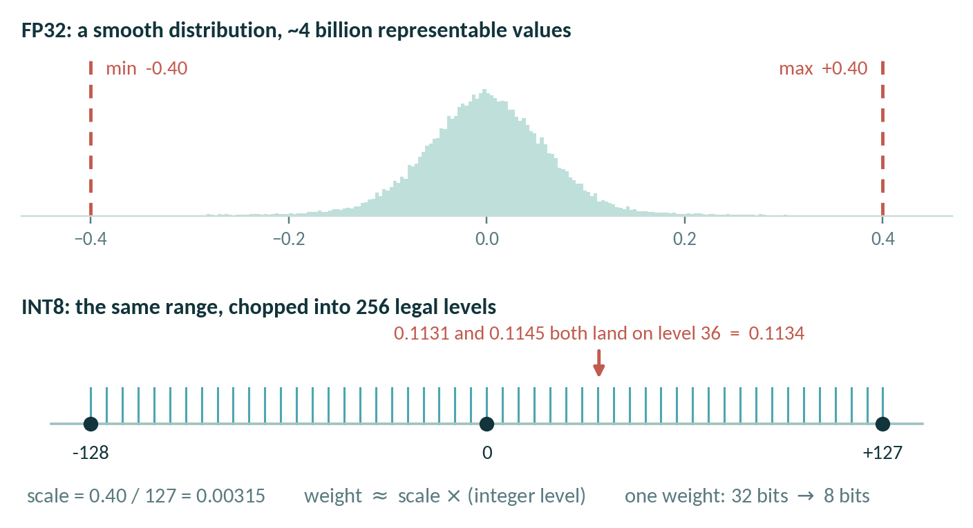
QUANTIZATION · THE MAPPING
Snapping a smooth range onto 256 steps
Calibration finds the range
Weights you can measure exactly. Activations you cannot, so you run a few hundred representative images and record how far the values actually reach.
PTQ · after training
Quantize a finished model using calibration data only. Minutes of work, no labels, no retraining. Start here.
Figure drawn for this session. Quantization form follows the ONNX Runtime definition: val_fp32 = scale × (val_quantized − zero_point).
QAT · during training
The whole game is choosing the range. Too wide and you waste levels on values that never occur; too narrow and the outliers clip.
Simulate the rounding in the forward pass so the weights learn to tolerate it. Costs a fine tuning run, recovers most of the lost accuracy.
Session 38 · Model Optimization

Slide 12
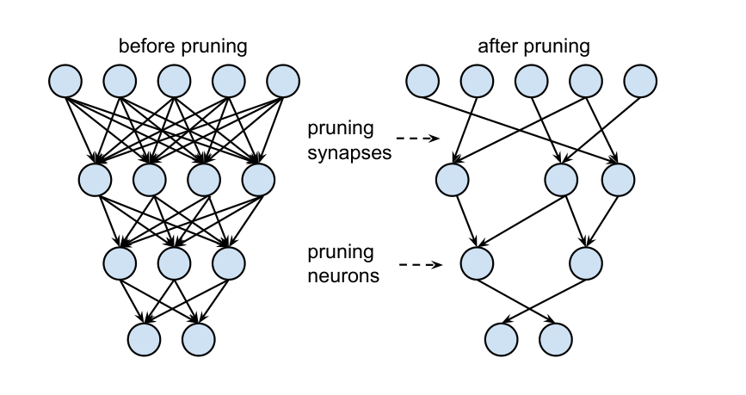
PRUNING · THE IDEA
Most trained networks are over parameterised
The observation
After training, a large share of weights sit very close to zero. They contribute almost nothing to the output, but you still store them and still multiply by them on every frame.
Magnitude pruning
Rank weights by absolute value, zero the smallest fraction, keep the rest. Crude, and still the baseline everything else is measured against.
Han, Pool, Tran & Dally (2015), Learning both Weights and Connections for Efficient Neural Networks, arXiv:1506.02626, Figure 3. Reproduced for teaching with attribution.
Retraining is not optional
THE LOOP
Prune without fine tuning and accuracy drops hard. Prune, retrain, repeat in small steps and the network reroutes around the missing connections.
Train
Prune
Retrain
Session 38 · Model Optimization

Slide 13
PRUNING · THE HONEST PART
A zero is still a number the GPU multiplies
Unstructured
Structured
2:4 semi structured
Zero individual weights anywhere.
Remove whole filters or channels.
Two zeros in every block of four.
Best accuracy per weight removed. Dense hardware still multiplies the zeros, so you get a smaller file and no speedup.
The layer genuinely shrinks, so every backend runs it faster with no special support. Costs more accuracy for the same sparsity.
50 percent sparsity in a pattern Sparse Tensor Cores on Ampere and later can skip. Real speedup, and NVIDIA reports the accuracy is recoverable by retraining.
Filled cells are surviving weights, pale cells are pruned. Diagram drawn for this session; the 2:4 pattern and its hardware support follow NVIDIA's structured sparsity documentation.
Rule of thumb: if nobody in your stack can exploit the sparsity pattern you produced, you compressed the file and changed nothing about the frame rate.
Session 38 · Model Optimization

Slide 14
TRADE-OFFS
Nothing here is free
Technique
What you gain
What it costs
What can bite you
ONNX export
Portability. One artifact that TensorRT, OpenVINO, CoreML and ONNX Runtime all read.
An export step in your build, and a graph you can no longer train.
Tracing silently freezes control flow. Unsupported operators fail late.
TensorRT
The largest single win on NVIDIA hardware: fusion, tuned kernels and memory reuse.
Minutes of build time and a binary tied to one GPU model, driver and TensorRT version.
NVIDIA only. Rebuild on every hardware or version change or it will not load.
Quantization
Smaller weights and faster maths. FP16 is close to free; INT8 roughly quarters the model.
Calibration data for INT8, and accuracy you have to measure rather than assume.
Outlier activations wreck the scale. Small objects and rare classes suffer first.
Pruning
Fewer parameters and a smaller file. With structured or 2:4 patterns, less work per frame.
A retraining loop, which means data, labels, and GPU hours.
Unstructured sparsity usually buys zero speedup on real hardware.
Session 38 · Model Optimization

Slide 15
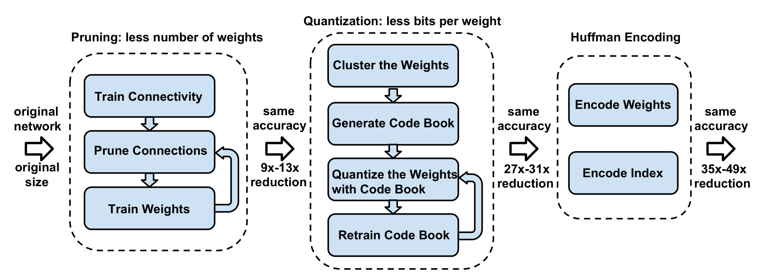
COMBINING THEM
They stack, in one particular order
Prune
Fine tune
Export to ONNX
Build with TensorRT
needs retraining,
so it goes first
recover the accuracy
you just spent
freeze the pruned
graph
fuse, tune, and set
INT8 or FP16 here
Quantization comes last because the compiler is the thing that can actually execute INT8 kernels, and it wants to see the final graph.
Why the order matters
Pruning after quantization means retraining a quantized model, which is harder.
Deep Compression showed the composition holds: pruning alone gave 9 to 13 times, adding quantization reached 27 to 31 times, with no accuracy loss reported.
Han, Mao & Dally (2016), Deep Compression, arXiv:1510.00149, Figure 1. Reproduced for teaching with attribution.
Session 38 · Model Optimization

Slide 16
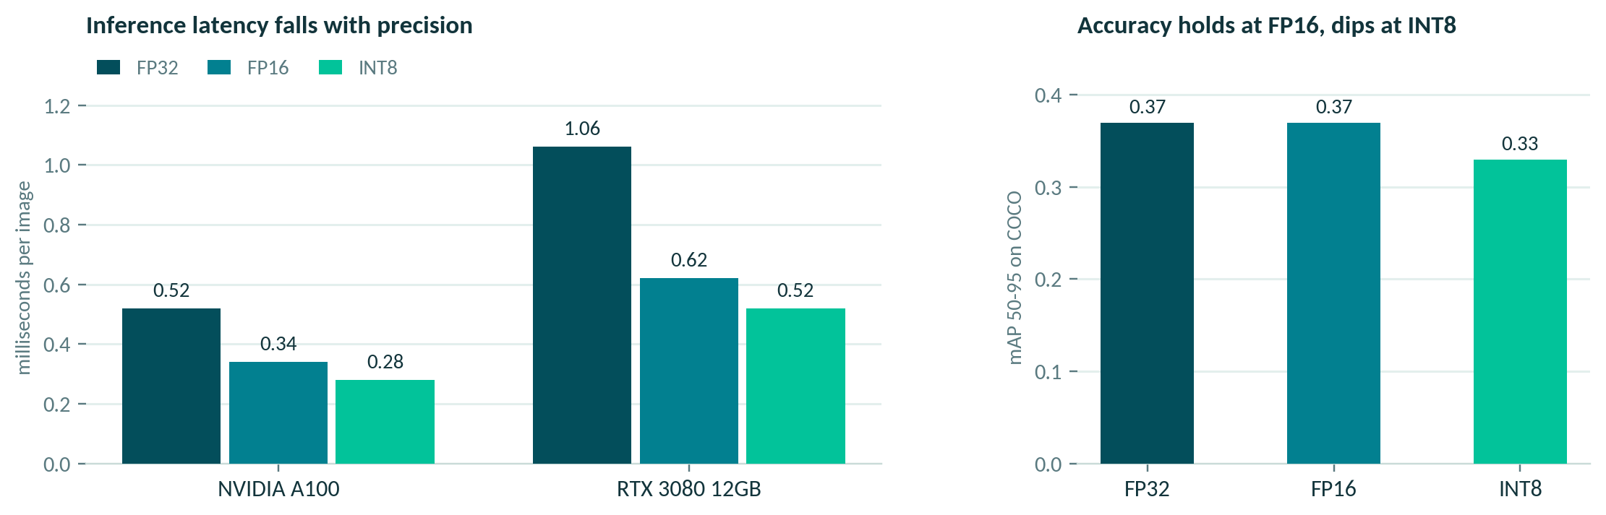
A WORKED EXAMPLE
One detector, four builds, real numbers
Ultralytics YOLO26 TensorRT export benchmarks, COCO detection. FP32, FP16 and INT8 engines built from the same ONNX graph.
FP16 is the default answer
INT8 is a decision, not a default
Calibrate on the deployment device
Roughly 40 percent faster than FP32 with identical mAP. If you do nothing else, do this.
16 percent faster again on the RTX 3080, and mAP 50-95 falls from 0.37 to 0.33.
NVIDIA advises at least 500 representative images, and warns results vary by device.
Session 38 · Model Optimization

Slide 17
SUMMARY
Which lever, and when
ALWAYS
Export to ONNX
Even if you never leave PyTorch. It is the artifact everything else consumes.
ON NVIDIA
Build a TensorRT engine at FP16
The biggest win for the least risk. Rebuild it on the deployment device.
WHEN LATENCY STILL HURTS
Try INT8 with PTQ, then QAT
Calibrate on real data, measure the accuracy drop, and decide against your written line.
WHEN THE MODEL MUST BE SMALLER
Prune, structured or 2:4
Budget for a retraining loop, and confirm your runtime can actually exploit the pattern.
And the rule that outranks all four: measure before, measure after, on the hardware you will ship. Every number in this session is somebody else's benchmark.

